Slide 1
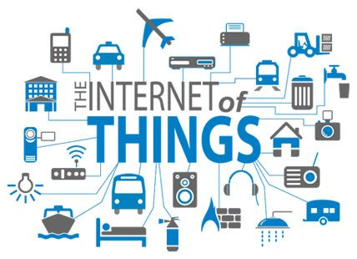

Slide 2
Text Books
Daniel Minoli , “ Building the Internet of Things with IPv6 and MIPv6: The Evolving World of M2M Communications ” , ISBN: 978–81–265–5823–0 , Wiley Publications, 2016
“The Internet Of Things: Connecting Objects to Web”, ISBN: 9788126566839, Wiley Publications,2017
Olivier Hersent, David Boswarthick, Omar Elloumi , “The Internet of Things: Key Applications and Protocols”, ISBN: 978–81–265–5765–3,Wiley Publications, 2015.

Slide 3
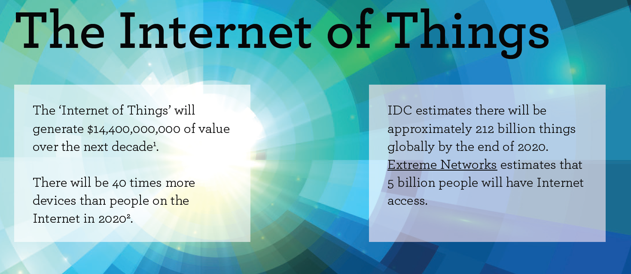

Slide 4
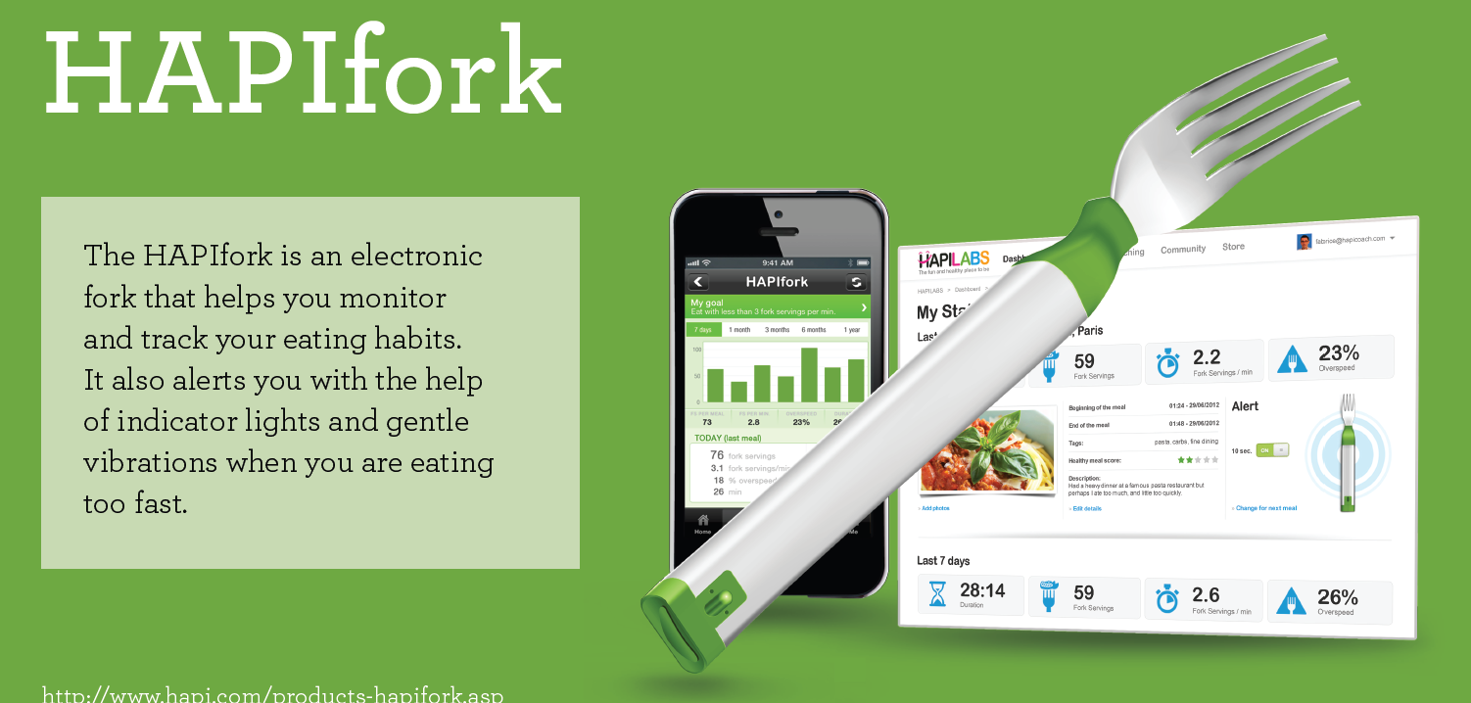

Slide 5
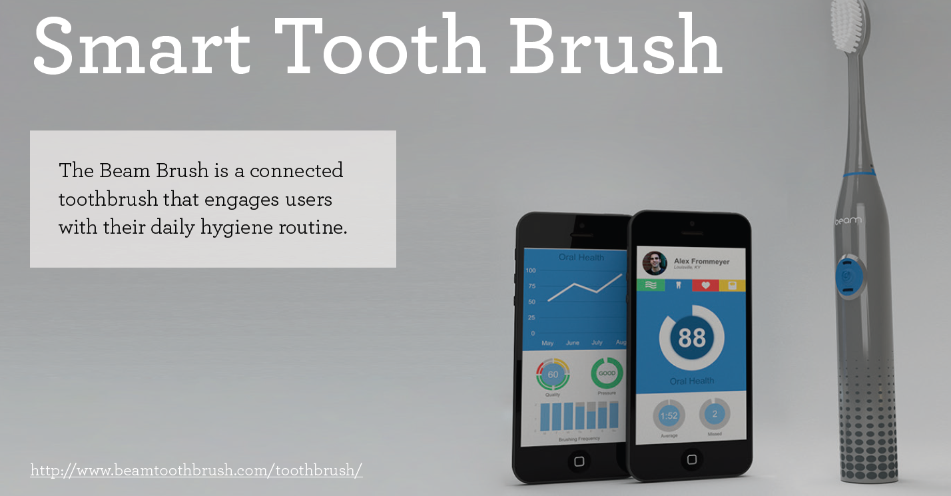

Slide 6
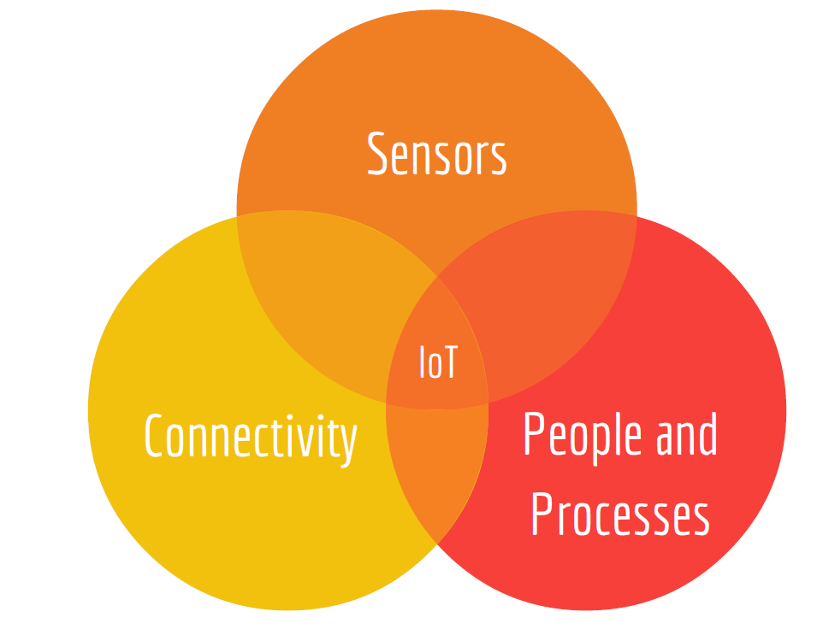
Question!
What is IoT? Why we need to study IoT?
The Internet of things (IoT) is the inter-networking of physical devices, vehicles, buildings, and other items embedded with electronics, software, sensors, actuators which enable these objects to collect and exchange data

Slide 7
Question!
2. What do we learn in this course?
Understand what Internet of Things is.
Apply the basic knowledge of RFID Technology, Sensor Technology.
Make use of different IoT Standards.
Understand the Radio Frequency Identification Technology.
Apply IoT on different areas
3. What will be the Assessment pattern?

Slide 8
Overview and Motivation
Initially , the internet connected host and terminals via specially developed gateways
Recently, the internet has connected servers of all kinds to users of all kinds seeking access to information
The next evolution is to connect all “things” and objects to control systems that support data connection, data analysis.
The term Internet of Things was first coined by “Kevin Ashton” a decade ago.

Slide 9
Overview and Motivation
Initial goal of the IoT is to enable connectivity to the various “things”
next goal is to be able to have the “things” provide back appropriate application specific telemetry
At the “lower end” of the spectrum, the thing’s information is typically coded by UID or EPC and stored in RFID (electronic tag)
The information is retrieved using RFID reader

Slide 10
Overview and Motivation
At the “mid range” of the spectrum, devices using microprocessors and perform a variety of wireless activities like data gathering and other control functions.
At the other end of the spectrum, more sensors can also be employed in the IoT, some of the approaches include WSNs
“IoT is also perceived as a global network that connects physical objects with virtual objects through the combination of data capture techniques and communication networks”
Some See IoT in the context of ambient intelligence

Slide 11
Overview and Motivation
The IoT eliminates the time and space isolation between geographical space and virtual space forming “smart geographical space”
A smart environment can be defined as consisting of networks of federated sensors and actuators and can be designed to encompass homes,offices,buildings

Slide 12
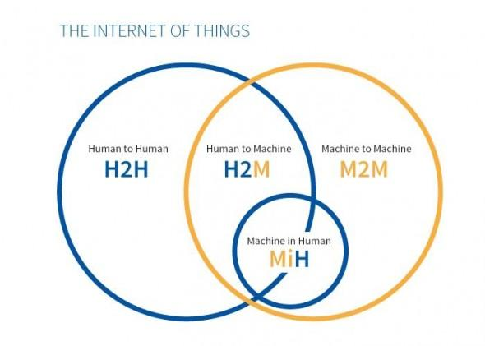
Overview and Motivation

Slide 13
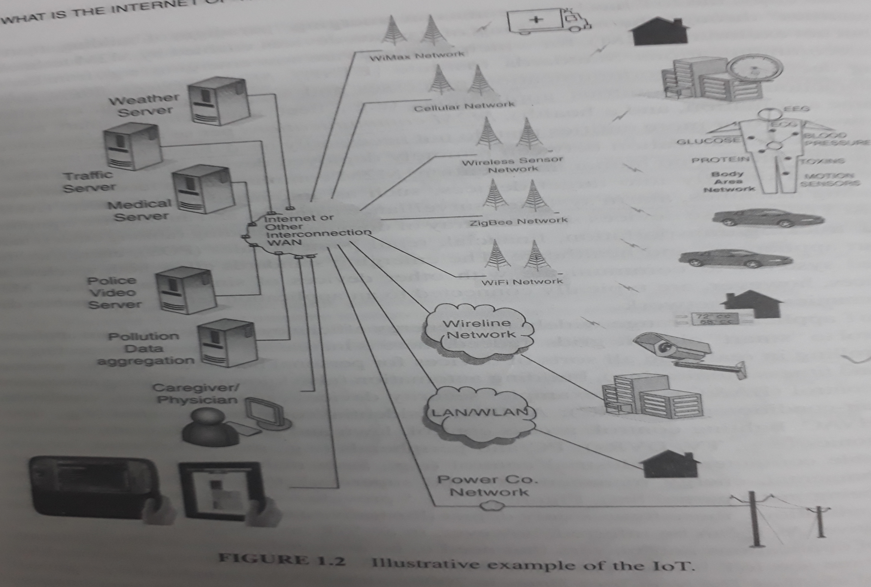

Slide 14
Examples of Applications
Things on Move
Retail
Food
Pharmaceutical
Ambient and assisted living
Health
Home
Transportation
Education and information
Environmental aspects/Resource efficiency

Slide 15
IPv6 Role
IoT may well become the “killer-app” for IPv6
IPv6 with its address spaces, unique object identification and connectivity can be done in a much standard manner
Scalability and expanded addressing capabilities
Plug-and-play: facilitates the connection of equipment to network
Security: encryption and authentication
Mobility: robust mobility mechanism

Slide 16
IPv6 Role
The goal is to retain the same explicit IP address and reach the far end destination
This is not possible with IPv4

Slide 17
Areas of Development and Standardization
With limited standardization, there are capability of mismatchs between different devices
there is also a mismatch between communication and processing bandwidth
Standardization at all layers/domains
Architectures and middleware's for IoT integration
Mobility Management
Cloud computing
End-to end security capabilities for the things
global connectivity

Slide 18
Internet of Things Definitions and Frameworks
IoT definition
IoT is an evolving type of internet application that endeavors to make a things information securely available on a global scale if/when such information is needed by an aggregation point or points
General Observation
IoT denotes a trend where a large number of device benefit from communication services that uses internet protocol
The M2M is an automated data exchange between machines

Slide 19
Internet of Things Definitions and Frameworks
Information Communication Technology (ITC) evolution has led to wireless personal devices such as smart phones, PDAs, computers
These devices are designed to operate over IP networks
The vision of the IoT is to attach tiny devices to every single object to make it identifiable by its own unique IP address.

Slide 20
Internet of Things Definitions and Frameworks
The success of IoT relies on overcoming the following technical challenges
the current manner of using IP addresses must change to a system that provides an IP address to every possible object
the power of embedded chips on devices need to be smaller and more efficient
The software application must be developed that can communicate and manage the stream of data from hundreds of system

Slide 21
Internet of Things Definitions and Frameworks
M2M describes that are connected to the internet, using a variety of fixed and wireless networks and communicate with each other and Wide world
Embedded wireless has been coined, for a variety of applications where wireless cellular communication is used to connect any devices

Slide 22
Internet of Things Definitions and Frameworks
ITU-T Views
the process of identifying a common way to define/describe the IoT
one can view the internet as an infrastructure providing a number of technological capabilities or as a concept to provide an array of data exchange and linkage services
Different IoT experts define it in different ways
view A: IoT is just a concept, its not a technical term but a concept
View B: IoT is an infrastructure

Slide 23
Examples of Definitions for (IoT is just a concept)
A technological revolution that represents the future of computing and communications, and its development depends on dynamic technical innovation in a number of important fields, like WSNs
the IoT is a world where physical objects are seamlessly integrated into the information network
IoT is a existing and evolving global ICT infrastructure that provide information services by interconnecting things

Slide 24
Examples of Definitions for (Infrastructural aspects)
The IoT consist of networks of sensors attached to objects and communication devices
The global network infrastructure, linking physical and virtual objects through exploitation of data capture and communication capabilities.
A global information and communication infrastructure enabling automated chains of actions facilitating information assembly and knowledge production

Slide 25
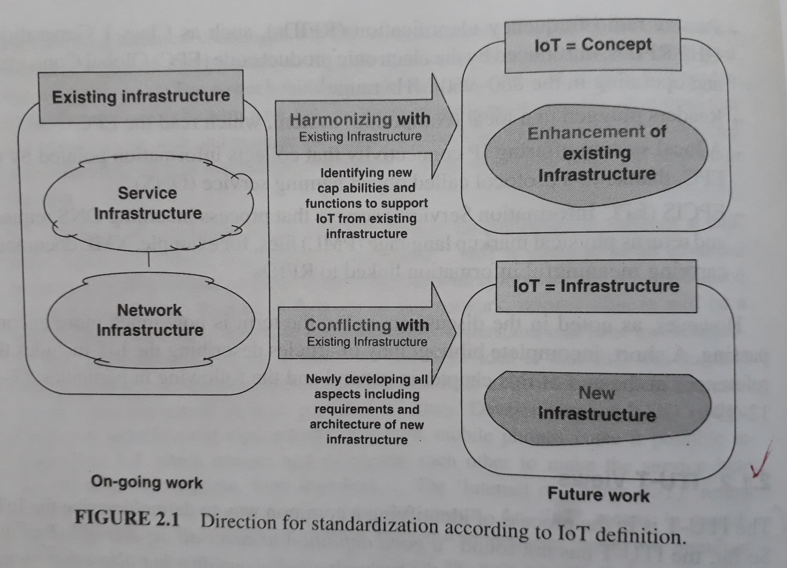

Slide 26
Working definition of IoT ,Sensors and actuators
A broadly-deployed aggregate computing/communication application and/or application-consumption system, that is deployed over a local (L-IoT),metropolitan (M-IoT), national (N-IoT)or global (G-IoT) consisting of dispersed instrumented objects with embedded one or two way communication and some computing capabilities
Sensors are active devices that measures some variable of the natural or man-made environment
Actuators is a mechanized devices of various sized that accomplishes a specified physical action

Slide 27
Working definition of IoT ,Sensors and actuators
The objects should have the following characteristics
have the ability to sense and/or actuate
Are generally small
Have limiting computing capabilities (not always)
Are energy/power limited
Are connected to the physical world
Sometimes have intermitted connectivity
Are mobile (not always)
Of interest to people
managed by devices not by people

Slide 28
IoT Frameworks
A high level M2M system architecture (HLSA)
The HLSA comprises the gateway domain, the network domain, and the applications domain
The device and gateway domain is composed of the following
M2M device: A device that runs M2M applications using M2M service capabilities
case 1 “Direct connectivity”: M2M devices connect to the network domain via the access network
M2M devices performs registration, authentication, authorization, management and provisioning of the network.

Slide 29
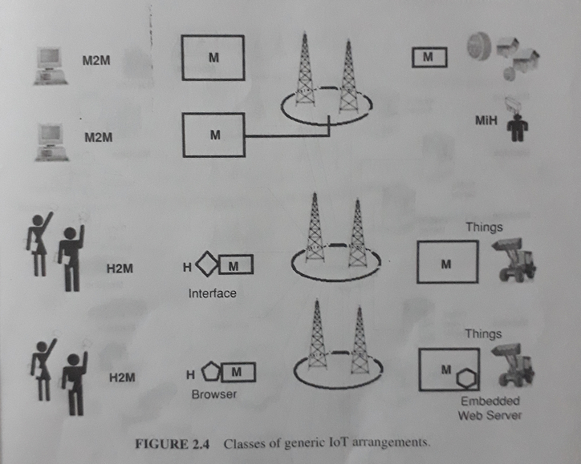
IoT Frameworks

Slide 30
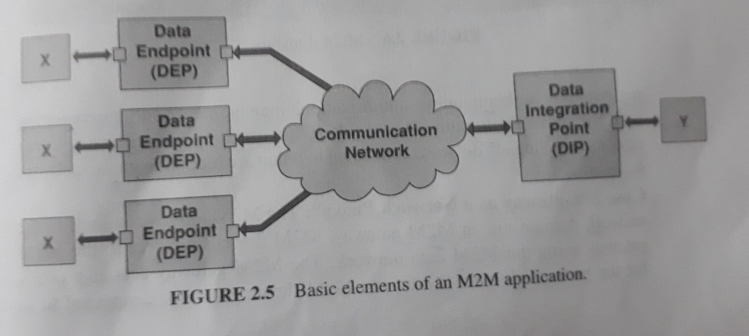
IoT Frameworks

Slide 31
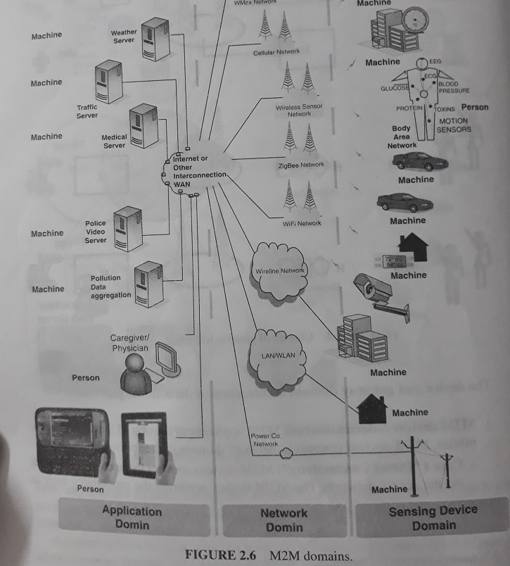
IoT Frameworks

Slide 32
IoT Frameworks
M2M area network: provides connectivity between M2M devices and M2M gateways
Examples include: personal area network technologies such as Zigbee, Bluetooth, M-Bus, Wireless M-Bus
M2M gateway: A gateway that runs M2M applications using M2M services capabilities
The M2M gateway acts as a proxy between M2M devices and the network domain
This gateway may run an application that collects and treats various information

Slide 33
IoT Frameworks
The network domain is composed of the following elements
Access network: A network that allows the M2M devices and gateway domain to communicate with the core network
Access network include GSM/EDGE radio access network (GERAN), W-LAN
Core network: A network that provides the following capabilities
IP connectivity
service and network control functions
interconnection
Roaming

Slide 34
IoT Frameworks
M2M service capabilities:
provide M2M functions that are to be shared by different applications
Expose functions through a set of open interfaces
Simplify and optimize application developed and deployment through hiding of network specifications

Slide 35
Basic Nodal Capabilities
Typical requirements include the following capabilities
Retransmission: Network recovers from packet loss and recovery is immediate
Scale: thousands of nodes and multiple link speeds
Multicast: Throughout network and reliable
Duplicate suppression
Emergency messages: routed/queued around other traffic
Polling of nodes: sequential and independent of response
Security: strong encryption and mutual authentication

Slide 36
Basic Nodal Capabilities
discover nodes
Discover node capabilities
Paradigm support peer-to-peer

Slide 37
INTERNET OF THINGS APPLICATION EXAMPLES
Public services and smart cities:
Telemetry: smart metering, parking metering and vending machines
intelligent transportation systems (ITSs) and traffic management
connecting consumer and citizens to public infrastructure
In-building automation, municipal and regional infrastructure
Metropolitan operations (traffic, automatic tolls, fire)
Electrical demand response (DR) at a global level

Slide 38
INTERNET OF THINGS APPLICATION EXAMPLES
Automotive, fleet management, asset tracking:
e-vehicle: navigation, road safety, traffic control
driver safety and emergency services
tracking: asset tracking, cargo tracking and order tracking
next-generation GPS
Commercial markets:
maintenance automation
home automation
wireless automated meter reading (AMR)
military sensors

Slide 39
INTERNET OF THINGS APPLICATION EXAMPLES
Embedded networking systems in smart home and smart office:
smart appliances: AC-power control, lighting control and heating control
Automated home: remote media control
Telehealth: e-health
security and emergency services

Slide 40
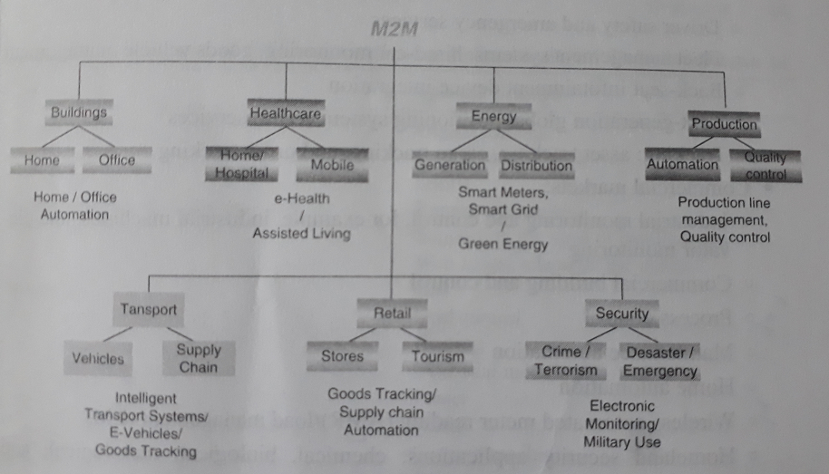
INTERNET OF THINGS APPLICATION EXAMPLES

Slide 41
SMART METERING/ADVANCED METERING INFRASTRUCTURE
The European Technology Platform for Electricity Networks for the future defines an “ an electricity network that can intelligently integrate the actions of all users connected to it”
A key element is smart metering network that enables automated metering capabilities on customer side
Smart metering network includes fault detection, isolation and resolution
smart metering network enables :
remotely connect/disconnect power to individual customers
remotely/automatically update the grid configuration
collect power consumption data in variable time interval

Slide 42
SMART METERING/ADVANCED METERING INFRASTRUCTURE
Modulate customers loads automatically during critical demand periods
This device should be automatically able to detect theft and is able to notify if a meter is tampered
The general goal is to monitor and control the consumption of utilities-supplied consumable assets, such as electricity, gas an water
The ultimate objective is to improve energy distribution performance and efficiency
A variation of this application for metering of gas, electricity and water is a pre-payment arrangement

Slide 43
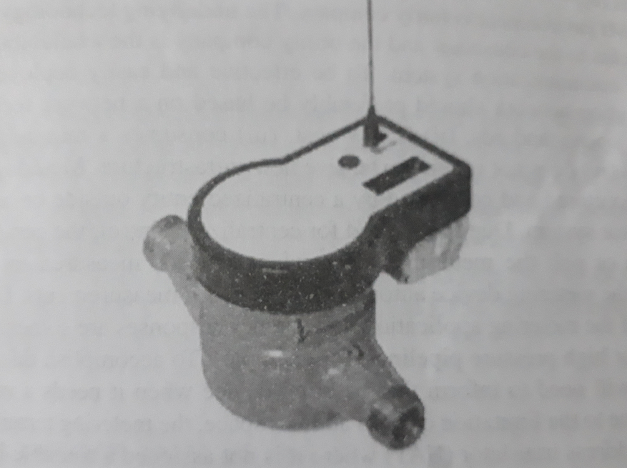
SMART METERING/ADVANCED METERING INFRASTRUCTURE

Slide 44
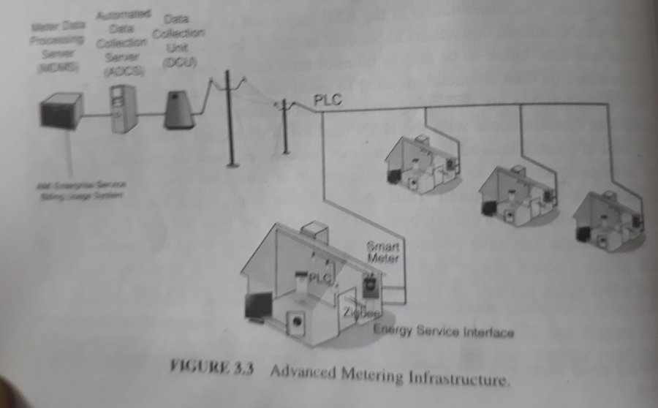
SMART METERING/ADVANCED METERING INFRASTRUCTURE

Slide 45
E-Health/Body Area Networks
These applications make use of one or more biosensors placed on/ in the human body
These sensors free patients from the set of wires, allowing the patient to enjoy a high degree of mobility
Sensors may consist of several wearable body sensor units, each containing a biosensor, a radio, an antenna and some on-board control and computation
These on-body sensor systems- the sensors and connectivity are called wireless body area networks (WBANs) / medical body area networks (MBANs)

Slide 46
E-Health/Body Area Networks
MBAN technology consist of small, low powered sensors on the body that capture clinical information (temperature and respiratory function)
Examples of healthcare sensors are:
Glucose meter
Pulse oximeter
Electrocardiography
social alarm devices

Slide 47
E-Health/Body Area Networks
Benefits of MBAN Technology
Transforming patient care, saving lives:
Almost 50% of all patients in US hospitals are not monitored
MBANs provide a cost-effective way to monitor patients
portions of MBAN spectrum can also be used outside the hospital and in patient’s home
Spurring Innovation in Mobile Health:
m-health industry consist of mobile app, cloud-based data management, wireless medical devices and other solutions .

Slide 48
E-Health/Body Area Networks
In mid-2012, the US Federal Communications Commission (FCC) announced it was planning to allocate spectrum bandwidth
This spectrum is used by sensors to monitor wirelessly a variety of patient’s vital signs using MBANs
The FCC’s MBAN proposes the new spectrum band (2360-2400MHz)
The proposed new spectrum allocation can:
provide more reliable services and increased capacity for use in MBANs
greatly improve the quality of patient care

Slide 49
E-Health/Body Area Networks
Personal Wellness monitoring includes the following:
Senior activity monitoring scenario
Safety monitoring scenario
Personal fitness monitoring includes the following:
monitoring and tracking fitness level
The personalized fitness schedule
Other demonstrations of MBAN technology include:
Fetal telemetry
LifeLine home care pendants
Predictive and early warning systems

Slide 50
City Automation
Traffic flow management system in combination with dynamic traffic light control
street light control
Passenger information system for public transportation
passive surveillance
Generic city sensors include environmental and activity sensors
thermal
Hygrometric
anemometric
sound
gas

Slide 51
City Automation
Activity sensors:
Pavement/roadway pressure
vehicle and pedestrian detection
parking space occupancy

Slide 52
Automotive Applications
stolen vehicle tracker
maintenance minder
Fault triggered

Slide 53
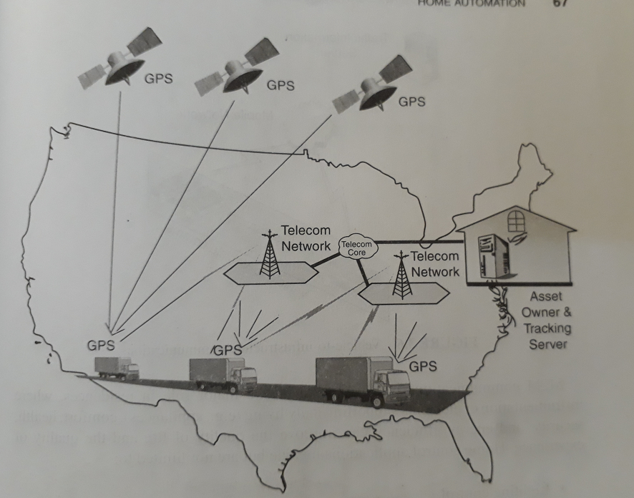
Automotive Applications

Slide 54
Home Automation
Home automation has received a lot of attention of late in the IoT/M2M context
Basic applications of the automated home includes remote media control, heating control, lighting control and other appliance control
Home control applications
Thermostat
white goods
Door Access phone
window locks
motion detectors
smoke/fire alert
Medical pendant

Slide 55
Smart Cards
Smart cards and M2M-based systems enabled wired & wireless communication for a large set of commercial and industrial applications
The purpose of an SC is to safeguard user identities, secret keys and to perform requisite cryptographic computations
Examples include: generic card acceptance devices (CADs), a setup box, laptop/ PC/tablet

Slide 56
Smart Cards
A more inclusive list of SC applications is as follows:
Cybersecurity
Enterprise ID
Government ID
Healthcare
Identity
Logical access
Market research
Mobile telecommunication
network security
payments
Privacy
RF/RFID tags

Slide 57
Smart Cards
Smart card can be of contact and contactless
Contactless cards can authenticate a person’s identity, determine the appropriate level of access
Whereas for Contact smartcards POS is an best example.
most of the POS is of wired connections
examples : parking meter, garage checkout booths
contactless cards uses NFC to communicate and receive power over short distance
NFC don’t need physical contact with a reader, they simplify operation and increases transaction speed

Slide 58
Smart Cards
there are three basic contactless technologies considered for physical access control applications:
125kHz, ISO/IEC 14443 and ISO/IEC 15693 technologies
125kHz read-only technology is used by many of todays RFID access control systems and is based on industry standards rather than international standards
125kHz allows secure and unique coded number transmission
ISO/IEC 14443 and ISO/IEC 15693 standards are intelligent, read/write devices capable of storing different kinds of data and operating at different ranges

Slide 59
Smart Cards
13.56MHz technology is divided into ISO 14443 and ISO 15693 devices with nominal operating ranges of up to 10 cm to 1m
ISO 14443 is used with most contactless smart cards popularly in commercial products

Slide 60
Tracking
Track and trace application are typical of automotive environments as well as of goods movement in production environments, distribution and retail
tracking can be done using GPS and also with cellular technology
Automotive applications are focused on
physical security for people such as emergency situation
asset tracking for theft or law enforcement applications
fleet management to achieve increased operational efficiency

